Slide 1
Students are to hold NOTHING on their laps during exam
Backpacks, bags, any other container except water on floor beneath desktop
No smart devices of any kind in view—stow them!
Allowed on desktop
approved calculator
Test form: 50Q-OMR or Scantron 95677
Pencil with dark “lead” (No. 2 or HB grade or better)
Eraser that works to erase
3x5 in index card, or cut paper, with HANDWRITTEN notes on both sides
Water container

Slide 2
What You Are Provided
The exam
  3 sheets of paper. The first two sheets have the exam questions. The 3rd sheet is blank with scratch paper
  Tear the 3rd sheet off and use it for writing: making calculations, composing poetry or a short novel…whatever purpose you set to it
Yellow sheet – periodic table one side, frequently used constants and conversion factors on other
Green sheet – lots of useful info related to chemistry
You are not to write anything on the Yellow or Green Sheets AT ALL.
You are only to write on scratch paper (3rd sheet of exam) or the exam itself

Slide 3
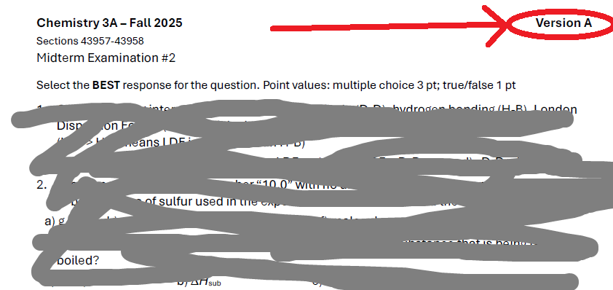
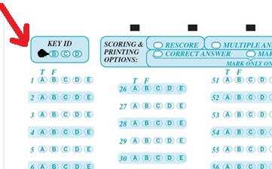
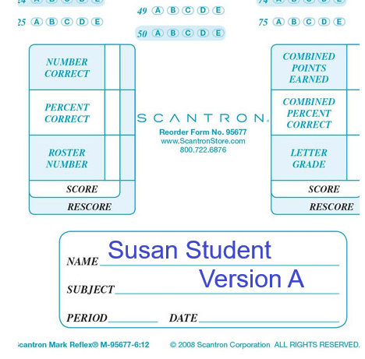
Mark the version written on your Name area AND that you fill in the oval (red arrow) of your Version
Be careful of multiple choice
(4 or 5 choices) and the True/False questions
Best wishes for your success

Slide 4
After You Have Completed The Exam
Bring your test form (50Q-OMR or Scantron) to me. It should have
  your Name
  your Student ID and writing and entered in the ovals
  your Version of test (A or B) in writing & entered in ovals
The Yellow and Green Sheets, with no marks on them, not folded or spindled or mutilated
You get to keep your exam, your 3x5 notes, your scratch paper
I will try to get the keys to versions up
I will try to get the exam with answers/explanations (part of the learning process that I believe in because that is how Aggies did it)

